Slide 1
Rome Maps

Slide 2
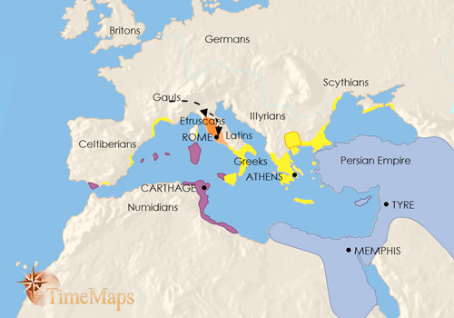
Rome 390 BCE
Having expelled its Etruscan kings and become a republic around the year 510 BC, Rome went to to become the dominant city of the Latin League - a group of Latin-speaking cities in central Italy.
In around 390 BC, however, Rome suffered a catastrophic defeat at the hands of a band of marauding Celts coming down from southern Gaul. The Romans withdrew into their citadel (central fortress) within the city, their houses were burnt, and they only narrowly stopped their citadel falling into the Gauls’ hands. The event shook the Romans profoundly and they remembered it for the rest of their history.

Slide 3
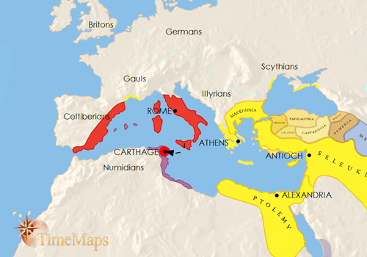
Rome 390-200 BCE
During generations of almost continuous warfare, the city of Rome first came to dominate a confederacy which spanned almost all Italy, and then emerged victorious from two long, bitter wars with its arch-rival, Carthage.
Victory in these struggles has made Rome the leading power in the western Mediterranean.

Slide 4
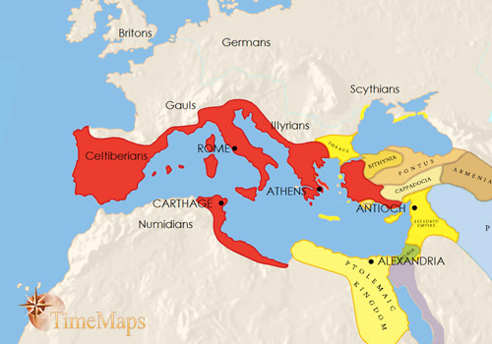
Rome 200-100 BCE
The Roman victory in the war against Hannibal (known to the Romans as the Second Punic War) left her as the dominant power in the western Mediterranean. She had also extended her overseas empire, this time in Spain. She soon found herself being drawn into further wars, which ended, in 146 BC, with her annexation of Macedonia, Greece and North Africa.
These conquests were followed by further Roman gains (in two cases, in Asia Minor, kings donated their kingdoms to Rome on their deaths). By 100 BC Rome dominated the lands surrounding the Mediterranean Sea, and directly controlled some of the wealthiest areas of the region.
While this expansion had been taking place overseas, at home things had been deteriorating for the Romans. The wealth that now flowed into Rome from her overseas territories, in the form of war booty and taxes, increased social tensions, as the rich got richer and the poor got poorer. This poisoned the politics of Rome, and led to political extremism and violence.

Slide 5
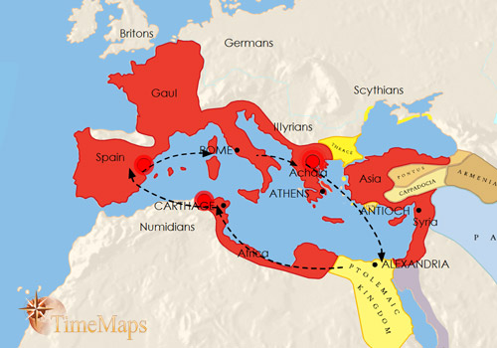
Rome 100-44 BCE
A plethora of civil wars between ambitious Roman generals has convulsed the entire Mediterranean world, had given power to autocratic leaders who completely overshadowed the civilian politicians. The lastest is Julius Caesar, who, after conquering Gaul, turned his armies on Rome and, after yert another civil war, made himself master of the Roman world. Then, on the 15th March, 44 BC, Caesar was assassinated by some of his enemies.
The Republic then began to slip into anarchy until Caesar’s three chief lieutenants, Antony, Octavian (Caesar’s grand nephew and adopted heir) and Lepidus, took control of the government. Caesar’s assassins fled to Greece, where, in 42 BC, they were defeated by the forces of Antony and Octavian.

Slide 6
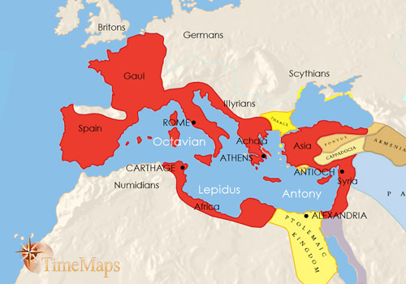
Rome 44-30 BCE
By 31 BC, the Roman Republic, which had existed for so long and whose power had now come to dominate the Mediterranean lands, existed in name only. An orgy of civil wars between ambitious generals, which have convulsed the entire Mediterranean world, had given power to autocratic leaders who completely overshadowed the civilian politicians. In the final round of civil war, the two protagonists were Julius Caesar's lieutenants, Antony and Octavian. This ended in 31 BC with Octavian victorious, and Antony - and Antony's mistress, Cleopatra, queen of Egypt - dead.
In 27 BC Octavian will rename himself Augustus, and become the first of the Roman emperors.

Slide 7
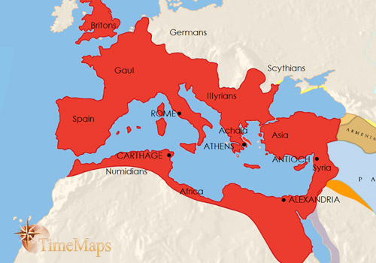
Rome 30 BCE-200 CE
The Roman Empire has continued to flourish and expand over more than two centuries. A brief civil war followed the death of the emperor Nero in 68, but stability was quickly restored. For most of the time the Roman world has ruled by a succession of able rulers such as Trajan, Hadrian and Marcus Aurelius; even when inadequate emperors have sat on the throne, the imperial machine, staffed by able officials and soldiers, has continued to hold the empire together.
The reign of the dreadful Commodus was followed by a civil war in 193-6; but peace and stability have returned under the victor, the Emperor Septimius Severus. The empire is divided into many provinces, each under the authority of a governor. The ancient cities – together with hundreds of new cities founded by the Romans – retain much of their autonomy, however. Millions of the empire’s inhabitants enjoy the rights of Roman citizenship, with full access to the famed Roman legal system. Economic activity has risen to a point the Mediterranean world will probably not see again until the 18th century.

Slide 8
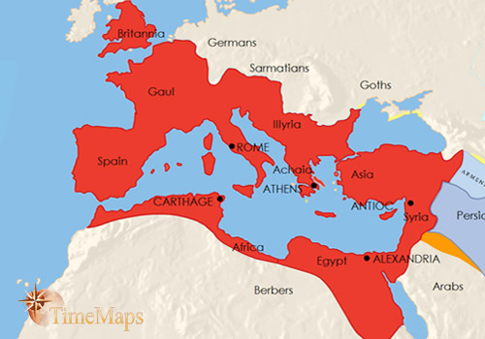
Rome 200-275 CE
After AD 225, numerous major barbarian invasions triggered fifty years of grave troubles for the Roman empire. Rebellions and mutinies occurred on a regular basis. Many emperors were assassinated, one emperor was killed in battle, and another was captured by the Persians. Barbarian hordes rampaged through the empire, sacking hundres of cities. By the 260s the empire looked as if it would break up.
However, several soldier-emperors then led a fight-back. The empire was reunited, and the barbarians driven from imperial territory. However, the wars and invasions had left the empire exhausted and impoverished.

Slide 9
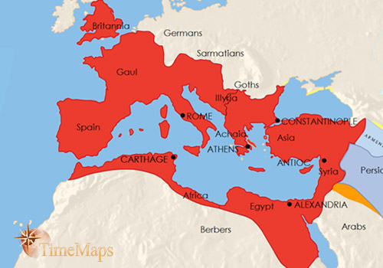
Rome 275-395 CE
The late third century and early fourth century emperors carried out wide-ranging changes. The Roman army was completely reorganized, with greater emphasis on cavalry; the administration was centralized, taxes greatly increased, and cities deprived of most of their cherished self-government. Emperors ceased to rule from Rome - and in fact, two or three emperors now ruled simultaneously, so as to control the empire better. Their capitals were now located at strategic points such as Milan, in northern Italy, and Trier, in Gaul. The emperor Constantine even built a brand new capital of the eastern Roman empire, at Constantinople.
Most dramatically, Constantine made Christianity, previously illegal and persecuted, into the imperial religion of the Late Roman Empire.
The fourth century emperors were often engaged in fighting barbarians on almost all frontiers. In 378 an entire Roman army was destroyed, and an emperor killed, at the Battle of Adrianople. The victorious Visigoths then went on a rampage through the Balkans.

Slide 10
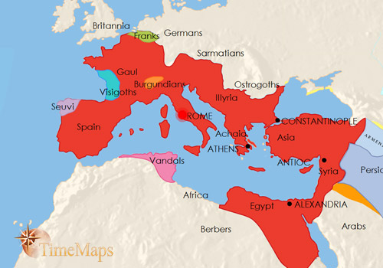
Rome 395-410 CE
In 410, the Visigoths moved west and sacked Rome.
This event triggered a mass invasion across the Rhine frontier by other German tribes. Some marched great distances, sacking towns and villas on the way, and settled hundreds of miles from their homelands. Within a few years a number of German-ruled kingdoms had begun to appear within the western Roman provinces. The provinces of Britain were lost altogether to the Romans, their garrison recalled to deal with threats to the heart of the empire.

Slide 11
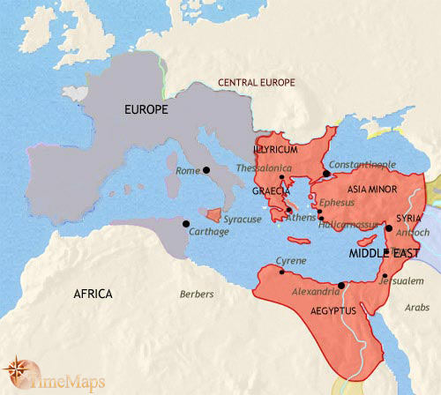
Rome 410-500 CE
As the 5th century progressed, more and more Germans entered the empire, particularly after a major attack on the empire by the Huns, in the 450s. Those already established within the empire extended their territories. It was now that the western Empire ceased to function as a going concern. In 476, the German leader in Italy sent the last Roman emperor of the west, a boy named Romulus Augustulus, into retirement.
Gone (or rapidly going) were the large towns, the beautiful villas, the well-built roads of the ancient Romans. Towns were smaller and trade shrank. The Christian church dominated the spiritual and intellectual life of the people. Rome, once the city of pagan emperors and senators, was now the city of the Pope, the leader of the western Christian church.
In the eastern Mediterranean the Roman empire is still very much a going concern, wealthy, civilized and stable. The Roman Empire would endure here for another thousand years. Centred on Constantinople, and fiercely Christian by religion, it would keep alive much of the old Greek and Roman civilization.

Slide 12
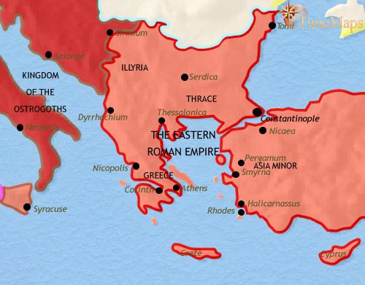
Eastern Roman Empire 500 CE
The Balkan provinces of the Roman empire are ruled from Constantinople, subject to the effective rule of the eastern Roman emperors. They have therefore been spared much of the turmoil visited upon the western provinces. They certainly have not escaped completely - from time to time over the past three centuries armies of Visigoths and others have roamed to and fro across them. Nevertheless, the provinces have been spared the worst of the upheavals, and provincial life remains largely intact. Ancient cities continue to thrive, remaining centres of Roman-Greek civilization.
Many of these cities are also now seats of Christian bishops, which in the eastern Roman empire is firmly under the control of the emperors in Constantinople. There is not that separation between secular and spiritual authority that is becoming increasingly marked in the west, where many Roman Christians find themselves under the rule of Arian Germans. Although they still regard themselves very much as members of the same faith, the eastern and western branches of the Church are already beginning to diverge.

Slide 13
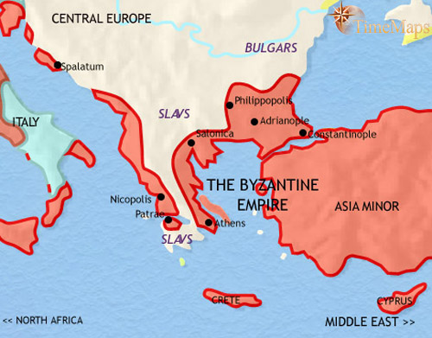
Eastern Roman Empire 500-750 CE
The Balkans remained under Roman (or, as we should now call it, Byzantine) rule until the time of the emperor Heraclius (610-641). At that time, a massive invasion, led by the Avar people from central Asia but composed mostly of their Slav allies, swept down to the very walls of Constantinople itself. Like so many other invaders, they failed to capture the great city, and were defeated by Heraclius. However, the Byzantines have been unable to reimpose their authority upon their old Balkan territories, except near the coast. In the meantime, the earlier populations have been swamped by Slav tribes, and city life has vanished from much of the region.
In the 7th century a new people, the Bulgars, arrived from central Asia and established themselves just north of the Carpathian mountains, conquering the Slav tribes living there. They defeated a Byzantine army sent against them and were then recognized as a separate kingdom by the Byzantine emperor (681). Thereafter the Bulgars and Byzantines have been involved in continual hostilities, with the Byzantines normally getting the upper hand.

Slide 14
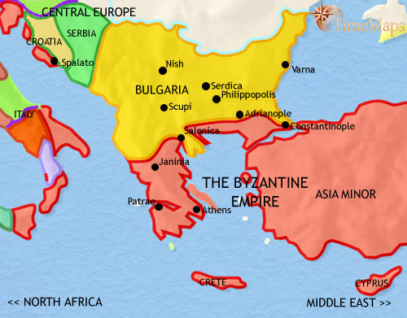
Eastern Roman Empire 750-979 CE
Byzantine forces have been able to gradually regain control over much of the territory lost to them by the Avar invasion of the 7th century, but they have faced another threat in the form of the Bulgars. In the 9th century a succession of Bulgar kings, having converted their people to Christianity, expanded their territory dramatically. However, more recently, internal instability and external attacks, from Magyars, Pechenegs, Byzantines and Russians, have weakend them.
Caught up in the struggle between the Bulgars and the Byzantines, two Slav groups, the Serbs and the Croats, have both established independent principalities. The Croats have accepted the Catholic Church, and therefore looks westwards towards the Holy Roman Empire for political and spiritual aid. The Serbians adhere to the Orthodox Church, and look to the Byzantines for support.

Slide 15
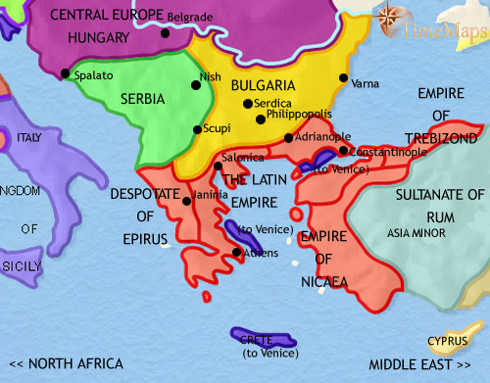
Eastern Roman Empire 979-1215 CE
The struggle between the Byzantines and the Bulgars continued. However, the Byzantines, under their emperor Basil II, won a crushing victory at the battle of Belasitsa (1014), which led to the Byzantine conquest of Bulgaria and its absorption into their empire. In 1185 the Bulgars won their independence again. Then in 1204, the Byzantines suffered a catastrophe as the Christian soldiers of the Fourth Crusade sacked the Byzantine capital, Constantinople, and installed one of their leaders there as emperor.
The Slav states of Croatia and Serbia have had varying fortunes. Croatia has become politically absorbed into Hungary, though the Croats retain their distinctive national laws and institutions, while Serbia has expanded greatly and is a strong, well-organized militaristic state.

Slide 16
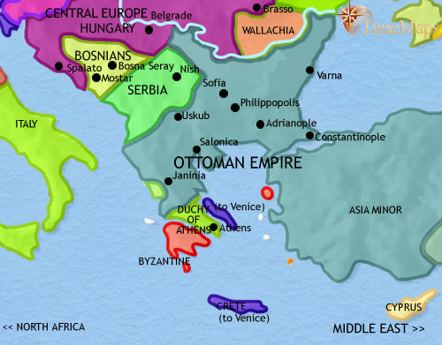
Eastern Roman Empire 1215-1453 CE
The northern Balkans were ravaged by the Mongols in the mid-13th century, with Hungary and Bulgaria being particularly hard hit. Then, in the 14th century, the Muslim power of the Ottoman Turks began spreading through the region.
The Byzantines, who had regained their capital of Constantinople and partially restored their empire in the late 13th century, were the first to feel the Ottoman onslaught. Although they retained Constantinople, they lost much territory to the Ottomans, who then turned north and conquered the Bulgarians and the Serbs. In this year, 1453, the Ottomans succeed in capturing Constantinople. They now pose an even graver threat to the independence of the remaining Christian states in the Balkans, and beyond.

