Slide 1
Middle Ages Maps

Slide 2
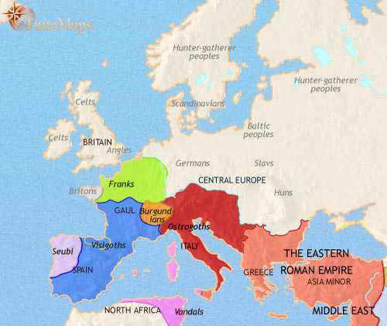
Europe 200-500 CE
The past three centuries have seen the Roman empire experience a long decline, and by AD 500 it has shrunk to itseastern half. The western provinces have been overrun by German tribes, and a number of Germanic kingdoms have been established: the Visigoths, Burgundians and Franks divide Gaul between them, and the Visigoths and Seubi share the Iberian Peninsula. North Africa has been occupied by another German tribe, the Vandals, and southern Britain is being settled by north German peoples. Even Italy, the heartand of the old Roman empire, is now under barbarian rule.
Civilization has taken a major hit here, and society is experiencing huge changes. The city-based way of life enjoyed by the Romans is in steep decline in western Europe. However, both in what remains of the Roman empire, and in the Germanic kingdoms of the west, Christianity has become the official faith.

Slide 3
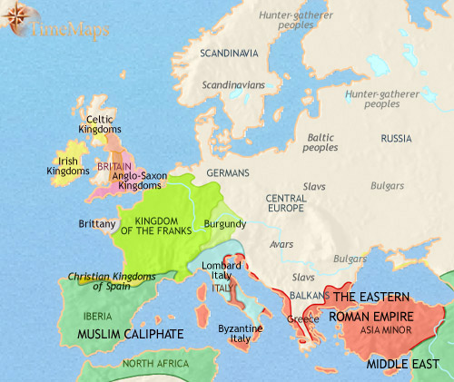
Europe 500-750 CE
The past two and a half centuries have seen the Franks come to rule most of modern-day France and much of Germany. Their kings are active supporters of the Catholic church and its leaders, the Popes. The Franks will shortly intervene in Italy to safeguard a Pope against his enemies, the Lombards.
Pagan tribes still inhabit central, eastern and northern Europe.England is now divided amongst a group of Anglo-Saxon kingdoms, with Celtic kingdoms to their north and west.
Most of Spain has been conquered by the vast Muslim Caliphate. To the East, the shrunken Roman empire (or Byzantine empire, as it should now be called) has also been battered by Muslim armies. Other enemies, pagan tribes from central Europe, have occupied most of the Balkans.

Slide 4
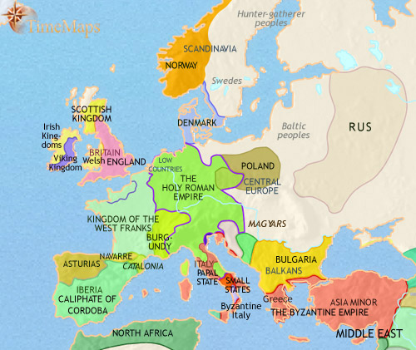
Europe 750-979 CE
The past two hundred years have seen the Frankish kingdom expand over much of Europe under its vigorous ruler, Charlemagne; but then, after his death, swiftly break up. The kingdom of France and the Holy Roman Empire have emerged from the wreckage.
Destructive invasions from outside - Vikings from the north, Magyars from the east and Arabs from the south - have hastened the disintegration of central power. In the widespread disorder a new, "feudal", society is taking shape.
Despite these troubles, Christendom is continuing to expand into central and eastern Europe (where the Rus state will shortly convert to Christianity), and the Balkans.
The Christian kingdoms of northern Spain have been able to chip away at Muslim power, but the British Isles have experienced massive Viking attacks.

Slide 5
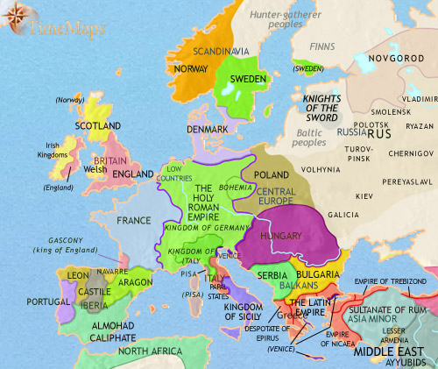
Europe 979-1215 CE
The previous centuries have seen the coming of the feudal age to Europe. It has also seen the church, headed by the Popes in Rome, reach the height of its power. Few kingdoms in western Europe have escaped its impact. In some places (for example,France) the church's influence has strengthened royal power; in other places (Germany and Italy) it has gravely weakened it. In yet others (England) the clash between royal and church power has been dramatic but indecisive.
Despite these tensions, Christendom has continued to expand innorthern, central and eastern Europe. In Spain, too, the Christian kingdoms have won territory from the Muslims. But Christendom's attempt to expand in the Middle East with a succession of great Crusades has failed: their most enduring result has been to undermine the strength of the Byzantine empire, Christendom's main bulwark against Muslim power in that quarter.

Slide 6
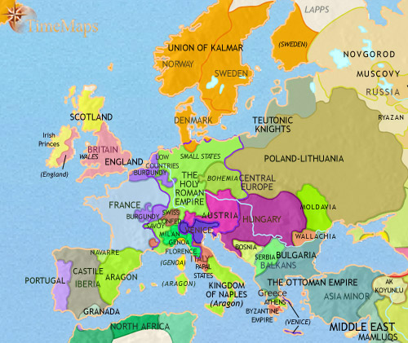
Europe 1215-1453 CE
The previous two centuries have seen Europe on the defensive. The Mongol conquest of Russia in the mid-13th century; the continuous warfare involving England, France and the Low Countries; continued political fragmentation in Germany and Italy; the terrible Black Death; widespread religious unrest, especially incentral Europe; and in this year, 1453, the fall of the historic Byzantine city of Constantinople to the Muslim Turks, whose power is now reaching far up into the Balkans, have all sapped European self-confidence.
On the other hand, the Christian kingdoms of Spain have all but completed their conquests of Muslim territory; Portuguese sailors have begun their voyages of discovery; the Italian Renaissance is now under way; and the first European printing presses will soon be spreading new knowledge and ideas across the continent.

