Slide 1
Maps of India

Slide 2
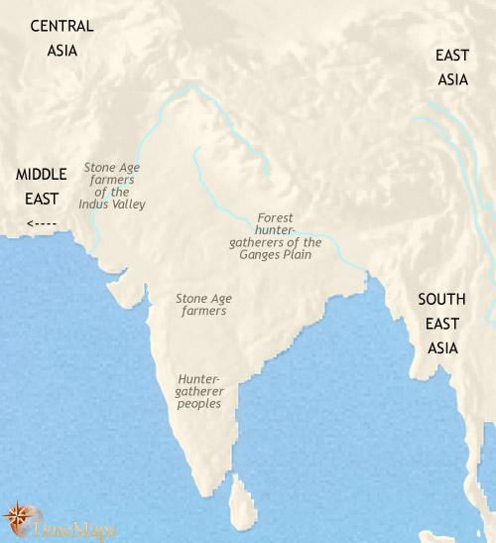
India 3500 BCE
The Indian sub-continent is home to a great variety of peoples. In the north and central regions, agriculture has been established for more than two thousand years, and populations of farmers grow barley, oats, rye, wheat, beans, peas and lentils, and keep goats and cattle (Zebu). In the north-west of the sub-continent, especially in the fertile Indus river valley, some communities have grown into sizeable villages. Craft specialization has appeared - the inhabitants produce high quality painted pottery and crafts including copper jewellery.
In central and southern India, farming is much more recent, and much of the land has still not been cleared for agriculture. Small farming villages are scattered across the land, surrounded by large tracts of untamed forest and savannah remain, sheltering populations of hunter-gatherers.

Slide 3
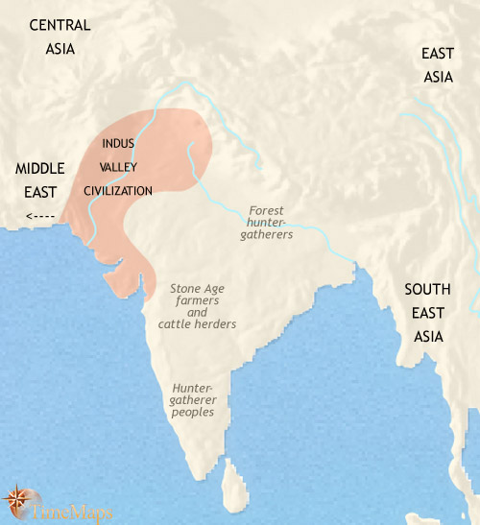
India 3500-2500 BCE
Over the past thousand years, towns and cities have appeared in the floodplain of the Indus river valley, covering a vast area. Some of these are amongst the largest in the world at this time. The history of this ancient civilization is very obscure, but it shows signs of having spread from a single centre, perhaps near the delta of the river Indus, across much of modern-day Pakistan and north-western India. The towns and cities show a high degree of uniformity of layout and design. The cities contain what are thought to have been granaries, public baths – perhaps for ritual purposes – and the earliest known sewage and drainage systems. In several of the cities the streets are laid out along a grid pattern – apparently the first case of town planning in history. There is an active trade with Mesopotamia. There is also evidence of a written script, but this has as yet not been deciphered by modern scholars.
In the rest of India, simpler, more ancient modes of life prevail, a patchwork of farming villages, hunter-gatherer bands and semi-nomadic pastoralists.

Slide 4
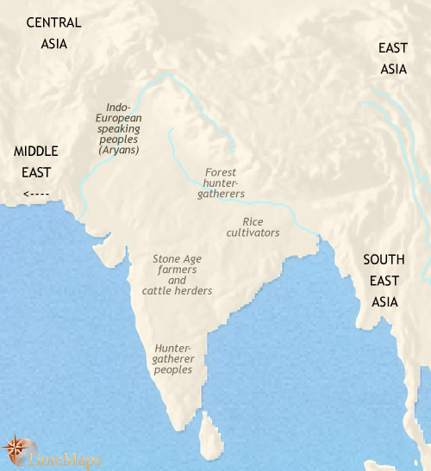
India 2500-1500 BCE
The past thousand years have seen the Indus Valley civilization flourish, until about 1800 BC. It then began to decline. The history of these centuries is obscure, but this decline has been linked by modern scholars to environmental factors, such as change in climate patterns or an overuse of land and water resources; migration by Indo-European tribes from central Asia may also have been another factor. In any event, by about 1700 BC the large cities of the Indus valley had disappeared altogether.
At about the same time, newcomers to India made their appearance, Indo-European speaking, semi-nomadic pastoralists from central Asia. They have brought with them the domestic horse and two-wheeled chariots, and have begun spreading out over the great plains of northern India. These “Aryans” are already starting to compose an oral poetry consisting of hymns, spells, rituals, dialogues and proverbs, which in later times will form the Vedas, the ancient foundation literature of Hindu civilization. These reflect a world under the rule of warrior aristocrats.

Slide 5
India Map worksheet 3500-1500 BCE
India 3500 BCE
1. What is being grown on the Indian farms?
2. What crafts were produced in the cities?
3. Why is civilization more advanced around the Indus Valley region?
3500-2500 BCE
4. What new advancements occurred in the next 1000 years from 3500-2500 BCE?
2500-1500 BCE
5. Why did the Indus valley civilization decline between the years 2500-1500 BCE?

Slide 6
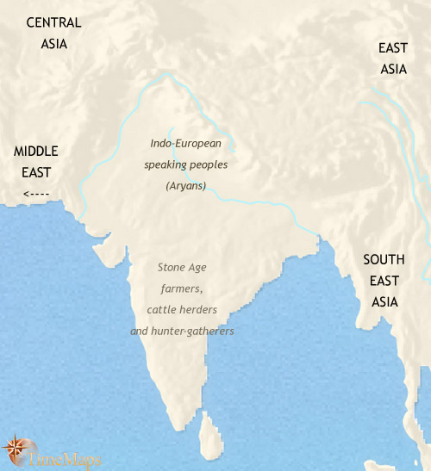
India 1500-1000 BCE
Over the past centuries the Indo-European peoples (Aryans) have spread across northern India, and are beginning to live in settled villages and tribal states. These are ruled over by the leaders of prominent Aryan clans, now emerging as kings. It is probably around this time that the four earliest castes appear in Aryan society: Brahmins (priests), Ksatriyas (warriors and rulers), Vaisya (the broad mass of tribesmen - farmers, craftsmen and merchants), and the descendents of conquered peoples relegated to a subservient role in society as Sudras (servants and labourers). This simple four-tiered caste system will become ever more elaborate as the history of India progresses. At this time also, a rich religious oral tradition is being developed, revolving around the doings of the Aryan’s pantheon of gods and goddesses. This will later form the Vedas, the most ancient scriptures of the Hindu world and one of the most important foundations for Indian civilization.

Slide 7
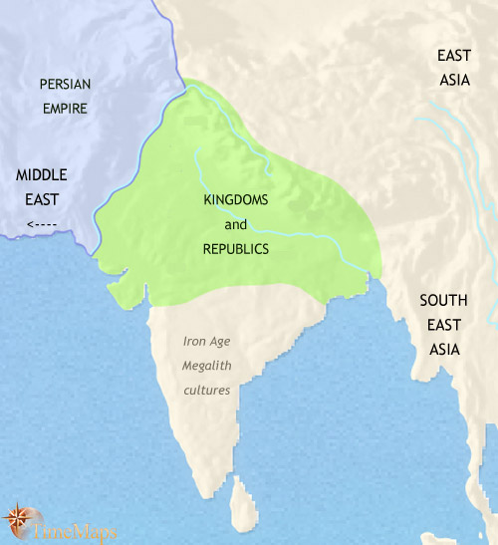
India 1000-500BCE
Over the past centuries, growing populations in northern India and expanding links with the Middle East have stimulated the rise of urban civilization again in the sub-continent. A network of towns, cities and trade routes is growing up, supported by highly productive agriculture using iron tools. A Sanskrit script is probably in use by this date and, shortly, a system of coinage will appear.
The various Aryan tribes have coalesced into sixteen major states which now cover northern India. Most of these states are ruled by kings, but some are republics, governed by oligarchies of noblemen.
This period of Indian history is one of great intellectual achievement. The foundations of early Hinduism have long been laid, but the religious assumptions that underpin it are being challenged from various quarters. Two teachings of enduring significance emerge from the spiritual and philosophical tensions of the time. These are Buddhism, which will be one of the most influential faiths in world history, and Jainism.
In southern India, the Tamils are emerging as the dominant group. The peoples of the south are adopting the use of iron implements, and farming is advancing at the expense of pastoralism and hunter-gathering.

Slide 8
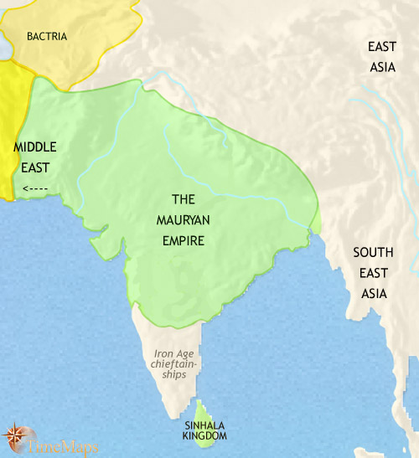
India 500-200 BCE
The past centuries have seen the first attempt at the conquest of the subcontinent by a western power, when Alexander the Great briefly led his army into the Indus Valley, in 327 BC. This episode was quickly followed by the rise of the first great empire in Indian history, that of the Maurya. At its height, this empire covered most of the sub-continent, together with neighbouring regions in central Asia. Its most notable ruler was the devout Buddhist king, Asoka (reigned 268-241 BC), one of the most remarkable figures in world history. He sought to apply his faith to ruling his vast territories. Since Asoka's death, the Mauryan empire has gone into decline, and will shortly fragment into many independent states. By that time, however, Aryan civilization will have become firmly established in central India, and soon the first large regional state will appear there. To the north-west, the presence of the Greek-ruled kingdom of Bactria is a conduit for western influences upon Indian civilization, and vice versa.

Slide 9
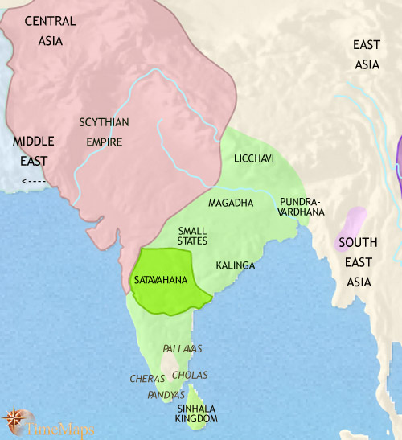
India 200-30 BCE
Since 200 BC the Maurya empire has vanished, a multiplicity of kingdoms springing up across northern India in its place. These have proved no match for the Scythians, a people from central Asia who have formed the first of the great Indian empires originating in central Asia. They now dominate much of northern India.
In central India, a powerful kingdom ruled by the Satavahana dynasty, has emerged, the first of a series of important kingdoms based in the Deccan. It has come under strong attack from the Scythians (or "Sakas", as they are called in India). The bone of contention between the two states is the west coast, with its growing Indian ocean trade with the Mediterranean world.
In South India the leading chiefdoms, the Cheras, Cholas, Pallavas and Pandyas, are beginning to transform themselves into organized kingdoms. The economy retains pastoral elements but is shifting more towards settled farming. The introduction of rice into this area is providing a spur to economic and population growth. Inscriptions testify to the spread of trade, towns and the religions of the north, Hinduism and Buddhism.

