Slide 1
Problem: Where are my notes for class?
I left it in my other notebook
I left it in my locker
I left it in my backpack
I left it at home

Slide 2
Results:
I can’t find my work
I have nothing to study
I receive a poor test grade
I receive a poor class grade
I have unhappy parents
I am unhappy grounded in my room while all my friends are outside having a good time without me………

Slide 3
The Solution: History Interactive Learning Log “HILL”

Slide 4
The purpose of the “HILL”
In an effort to maximize learning, each student will need to keep an individual, personal learning log or interactive notebook, which will be a way for you to measure your day-by-day progress. Hopefully, by completing this each class period, you will be able to:

Slide 5
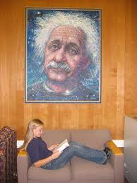
Process and retain social studies’ concepts
Review for quizzes and tests

Slide 6
Keep track of the assignments, homework and class progress on a daily basis
Have a study tool for the final exam at the end of the year

Slide 7
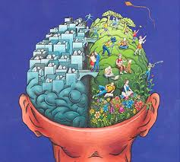
Personalize your learning experience in social studies by having a means to reflect thoughtfully, creatively, and individually

Slide 8
Requirements
Spiral notebook* (at least 8.5”x11”) with at least 150 pages
Glue sticks
Colored pencils for artwork (NO MARKERS OR FELT-TIP PENS)
*A second spiral notebook may be needed for the second semester if first semester notebook is in poor condition or full.

Slide 9
Structure
The structure of the interactive learning log will generally be:
A date for each entry
A page number for each entry (as assigned by the teacher)
Notes, skill checks, study guides and labs providing content will always go on the right page of the spiral notebook.
Processing activities such as letters, artwork, stories, speeches, scripts, concepts maps, outlines, etc., will always go on the left page of the spiral notebook. Always use color, it helps the brain learn and organize information.

Slide 10
Set up
A date for each entry
A page number for each entry
Processing activities such as artwork, stories, and speeches will always go on the left hand side
Student input
Teacher
input
Handouts, notes, study guides, maps and charts will always go on the right hand side

Slide 11
IT IS YOUR RESPONSIBILITY TO GET THE MATERIAL AFTER AN ABSENCE AND ADD IT TO YOUR HILL!

