Slide 1
Greek Maps

Slide 2
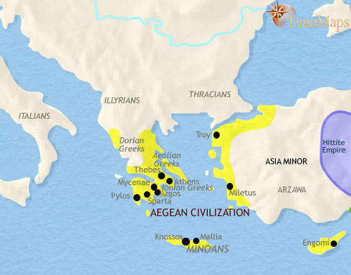
Greece 1500 BCE
On the island of Crete, the first civilization in European history - theMinoan - has been flourishing since around 2000 BC. This is centred on some of the most sophisticated palace-complexes in the world at that time, distributed across the island. Of these, Knossos is the largest and most elaborate. Minoan Crete is a well-developed state with trading contacts throughout the eastern Mediterranean. On the mainland of Greece and throughout the Aegean sea, another civilization, the Mycenaen, also flourishes. This consists of many small kingdoms, at Mycenae, Troy and other places famous in the epics of later Greeks, and ruled by warrior lords in their thick-walled palaces.

Slide 3
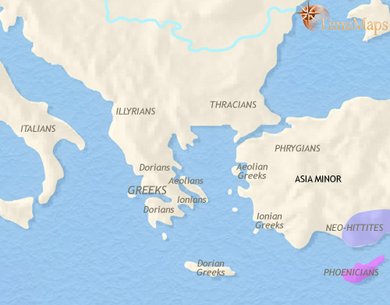
Greece 1500-1000 BCE
The past few centuries have been tumultous ones for the inhabitants of Greece and the Aegean. The Minoan civilizationof Crete came to an abrupt end about 1400 BC. The Mycenaean world continued to flourish, however, and southern Greece was the centre of a trade network which dominated the eastern Mediterranean. Mycenaean colonies appeared in southern Italy, Sicily, Asia Minor, and as far as Egypt and Palestine. After 1200 BC, however, this civilization too fell into rapid decline, a process almost certainly connected to the movement of peoples from central Europe. Evidence of writing and other features of a more complex society vanished at this time. Thus ended the first ancient European civilizations. Greece is now home to small-scale, illiterate tribal societies.
About now, however, the islands and coasts of Greece and the Aegean are starting to be visited by Phoenician merchants, from Syria. Through their influence, the Greeks will be reintroduced to literate civilization during the coming centuries.

Slide 4
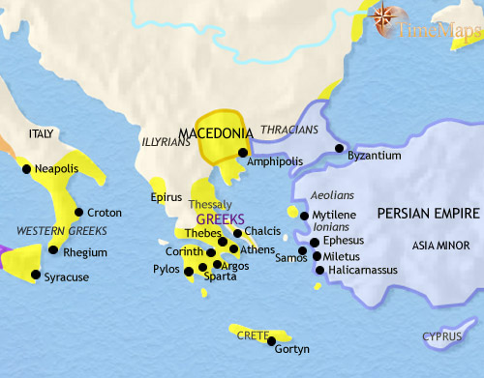
Greece 1000-500 BCE
The region of Greece and the Aegean Sea is fragmented into steep mountains and valleys, as well as many small islands. Over the past centuries this has caused the populations here to form several hundred tiny city-states. The mountainous nature of the landscape has encouraged coastal Greek states to look out to sea. Many have sent out overseas colonies, so that Greek culture is now spread far and wide across the Mediterranean basin.
In the centuries after 1000 BC, contact with Phoenician traders from Syria led to the introduction of the alphabet, amongst other things.
By this period, most Greek city-states have a republican form of government. Political life in these states is often unstable, but they allow a degree of freedom unknown in other lands. This has given rise to the dramatic intellectual achievements of Greek civilization. Some of these states have become the first democracies in world history; the largest is Athens, soon to be one of the most famous centres of culture in the ancient world.

Slide 5
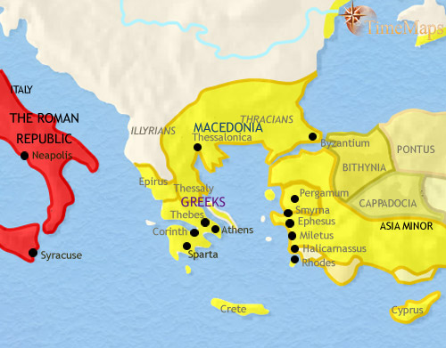
Greece 500-200 BCE
The years after 500 BC saw the Greek city-states, under the leadership of Athens and Sparta, see off an attempt by the mighty Persian Empire to conquer them. This struggle opened two centuries in which the Greek city-states reached their brilliant cultural peak, culminating in the philosophical achievements of Socrates, Plato and Aristotle. These would lay much of the foundations for two thousand years of European thought. The cultural brilliance was accompanied by unceasing warfare, however, when led to the Greek city-states being eclipsed by new, larger powers.
To the north of Greece, the kingdom of Macedonia rose to prominence under Philip II (reigned 359-336 BC) and even more so under his son, Alexander the Great (reigned 336-323 BC), under whom it briefly controlled one of the largest empires the world has yet seen. Since then Macedonia has played its part as one of the leading kingdoms of the region, along with Egypt and Syria. These kingdoms now overshadow the many small city-states of Greece.

Slide 6
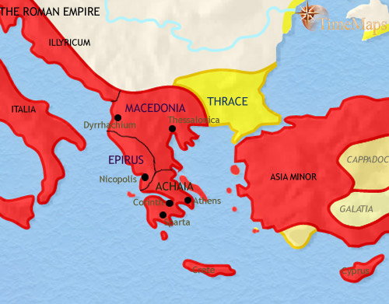
Greece 30 BCE
The Greek city-states and the kingdom of Macedon were no match for the rising power of Rome, and by 146 BC, after a series of wars, the Romans were in complete control of the region. The Roman occupation culminated in the destruction of the famous city of Corinth, since been resurrected as a Roman colony by Julius Caesar. Roman governors now rule these provinces, but the Greek cities continue to elect own magistrates and run their own affairs. The late Roman Republic saw a degree of oppression and misrule by several Roman governors, but now, under the firm rule of Augustus, the people of Greece know peace and good governance. When the Romans annexed Macedonia and Greece, in 146 BC, they gave the Thracians their own kingdom. Since then the Romans have had to get involved in the power struggles within the Thracian royal family from time to time, and will eventually be forced to annex the kingdom entirely.

