Slide 1
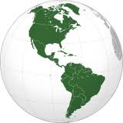
Early American Maps

Slide 2
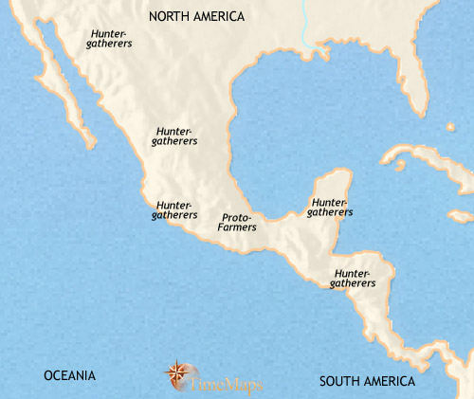
Meso-America 3500 BCE
The peoples of Mesoamerica originally came from the north, many thousands of years before. Most are hunters and gatherers, living in small, temporary settlements as they move regularly from location to location in search of game and forage. However, there are some small scattered communities which are making the transition from hunter-gathering to farming. They grow such crops as beans, manioc and yams, and some maize - though this is not an important food source, probably because the fully domesticated plant has yet to evolve. They rear turkeys and dogs for eating. As well as growing food, hunting and gathering provides a large part of their diet.

Slide 3
Meso-America 3500-2500 BCE
Farming communities are gradually spreading across present-day Mexico. At the same time, these communities are placing increased emphasis upon growing crops and rearing small animals for their food, at the expense of hunting and gathering. This development is linked to the slow development of fully domesticated maize, which are easier to harvest and a great deal more nutritious than the wild varieties. At this time, also, the first pottery appears in Mesoamerica. Nevertheless, throughout Mesoamerica most of the population remains at the hunter-gatherer level of subsistence, and some areas which would later play a predominating role in the development of Mesoamerican civilization, such as the Yucatan Peninsula and the central Valley of Mexico, were very thinly populated at this date.

Slide 4
Meso-America 2500-1500 BCE
By this date farming is well established in Mesoamerica, with the fully-developed domestic maize as the staple crop. Farming villages are located mostly in the west of Mesoamerica, and on the coast of the Gulf of Mexico. Also, farmers are beginning to colonize the central Valley of Mexico.
On the Gulf coast in particular, large villages are developing, as the people (known to modern scholars as the Olmec) learn how to take advantage of the fertile soil of the rivers and coasts by digging ponds and channels to control the flow of water to best advantage.
Elsewhere in the region the hunter-gatherer lifestyle remains the norm, and it will only gradually give way to farming.

Slide 5
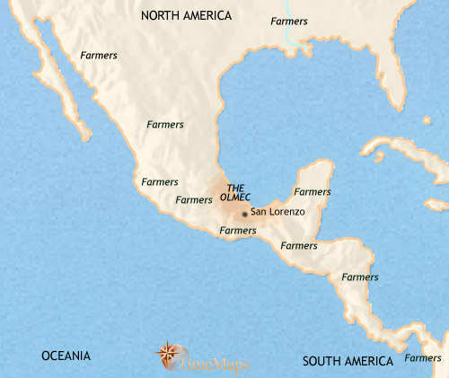
Meso-America 1500-1000 BCE
In the coastal lowlands of Mexico, the rich soil of the river mouths has allowed intensive farming to give rise to a dense population. Here, elite groups have emerged who are able to control the labour of large numbers of farmers, and a more complex society has come into being. With this labour at their disposal, the rulers build imposing ceremonial centres, adorned by superbly-crafted sculptures and other works. These centres act as the focus for the religious life of the region, and from them the rulers are clearly able to exercise a high degree of control over the surrounding countryside.
Thus what many scholars regard as the earliest civilization of Mesoamerica has emerged, that of the Olmecs. Complex societies are also evolving in other parts of Mesoamerica, though not on the scale of the Olmecs. Trade routes now span the region, and along these Olmec influences reach out throughout the region, laying the foundations for all future Mesoamerican civilizations.
Hunter-gatherer populations still inhabit much of the region, and it is only about now that the lowland forests of the Yucatan Peninsula, the later heartland of the great Mayan civilization, begin to be settled by farmers.

Slide 6
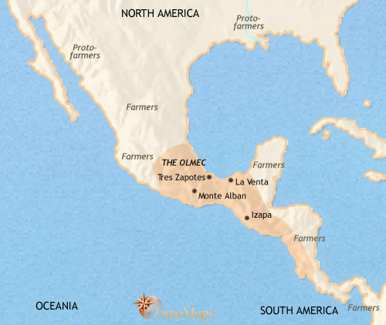
Meso-America 1000-500 BCE
The Olmec have expanded their cultural influence over a large area of Mesoamerica. They have pioneered distinctive features of Mesoamerican civilization – stepped pyramids, the production of beautiful ceremonial objects, priestly authority, a complex pantheon of gods and the mysterious ball-game arenas. One of the unique Olmec features, however, is the carving of enormous basalt heads, probably representing local rulers.
By this date at the latest the greatest of the early Olmec centres, at modern San Lorenzo, has experienced a mysterious fate: its sacred sculptures have been deliberately desecrated and buried, and the ceremonial centre deserted. Other Olmec centres continue to flourish, however, and the Olmec trade networks have continued to expand.
Other centres of civilization with non-Olmec characteristics are also emerging, revealing that other peoples are being influenced by the Olmec but not absorbed by them. This process, of widening influence but not absorption, is laying the foundations of Mesoamerican civilization on which successive peoples will build in the future.

Slide 7
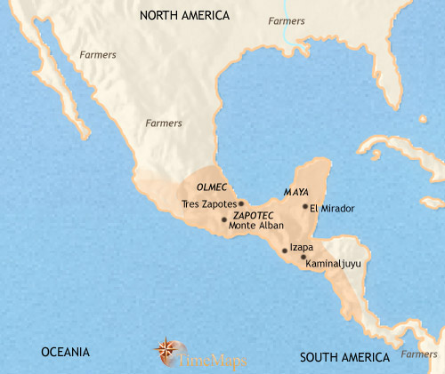
Meso-America 500-200 BCE
By this time, the centres in the Olmec heartland are in decline. Several of them have experienced the mysterious fate of having their ceremonial structures and objects deliberately and elaborately desecrated, and their central areas deserted.
Elsewhere in Mexico and Mesoamerica, other centres, such as those of the Zapotec, the Mixtec and the early Maya, continue to develop. Indeed, this is a period of strong population growth, especially in the Mayan heartland of the Yucatan lowlands and in the central Valley of Mexico. Some centres are growing into the earliest cities of Mesoamerica, most notably at Monte Alban, in the west, and Teotihuacan, in the Valley of Mexico.
As well as physical expansion, these Mesoamerican societies experience continued cultural advance. Almost certainly by this date the first writing system has been developed, and the highly sophisticated Mesoamerican calendar, which involves two separate but inter-meshing dating systems, has appeared.

Slide 8
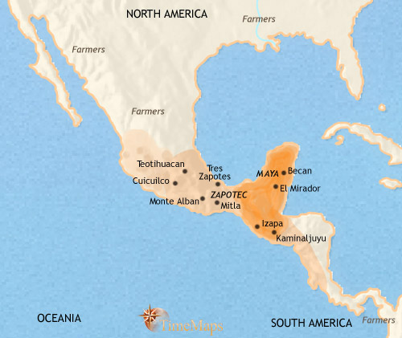
Meso-America 200-30 BCE
Strong population growth continues to affect the region, and cities continue to grow, in number and in size. The early Mayan city-states have begun to emerge, and urban society is developing on the western coast, amongst the Zapotec people.
It is in the plateau of central Mexico, however, that the most dramatic development is taking place. Over recent centuries, a large farming population has become established here, taking advantage of the fertile volcanic soil and the system of lakes and streams with their plentiful supply of aquatic food. On this base, several large states emerged, their capitals dominated by pyramid mounds. From c. 300 BC, however, a major city suddenly appeared to the north, Teotihuacan. This now probably houses as many as 60,000 people and dwarfs any other urban settlements in area (and indeed, in the entire New World). This indicates that its ruler has eliminated the other states; the new city has certainly drawn in the populations of the older capitals, and it will continue to grow in the future.

Slide 9
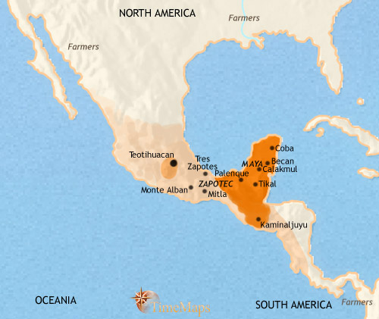
Meso-America 30 BCE-200 CE
A widespread network of city-states spreads over Mesoamerica, all sharing common cultural traits but each region bearing distinctive features. In the Yucatan Peninsula, a group of city-states are developing which will, over the coming century, become the home of the classic Mayan civilization. Some of these are already large cities by this date, major centres of high culture.
Most dramatically, a huge city, one of the largest in the world at this time, has appeared in the Valley of Mexico. Teotihuacan has a population of some 150,000-200,000 people by this time. It is sustained by an intensive system of irrigation agriculture, and has sucked in the population from a large area of the surrounding country. The centre of the great city of Teotihuacan has been remodelled on an imperial scale, with the huge pyramids of the Sun and the Moon the centrepieces.

Slide 10
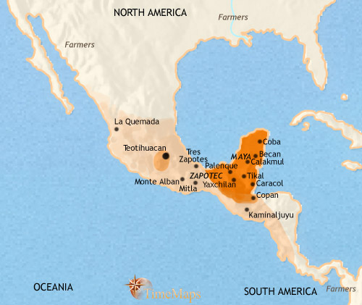
Meso-America 200-500 CE
Teotihuacan continues to thrive. The great city exercises an influence which extends throughout the length and breadth of Mesoamerica. To what extent this is based on commercial ties or military power is unknown - no records have survived, even though this is a literate civilization.
In the lowlands of the Yucatan Peninsula the Mayan city-states have now reached their classical period. Teotihuacan exercises a strong cultural - and perhaps political - influence in the region, but the Maya are developing a mature, vibrant civilization of their own, which will soon experience the greatest cultural flowering in Pre-Columbian American history.

Slide 11
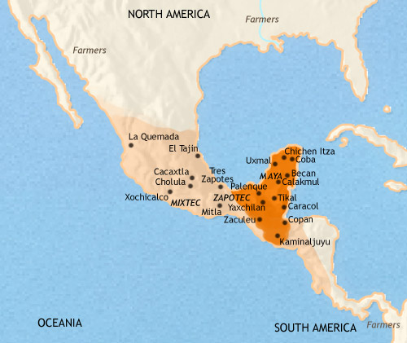
Meso-America 500-750 CE
At about this time Teotihuacan is destroyed, after a century or so of decline. Temples are violently desecrated, monuments thrown down, and the entire city torched. In the aftermath, the Valley of Mexico is divided amongst several small city-states, each vying for Teotihuacan’s inheritance.
On the Yucatan Peninsula the Mayan civilization continues to flourish. The city states compete with one another both militarily and culturally, stimulating a very high level of artistic achievement in sculpture and architecture. In mathematics, they are more advanced than most peoples of the Old World at this time: they understand the concept of zero, and use a numeration system based on the same principle as decimal places. They also have an extremely accurate calendar, and a mastery of the science of astronomy.

Slide 12
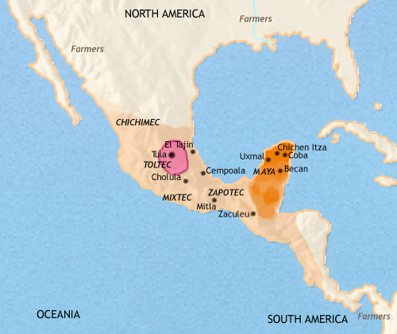
Meso-America 750-979 CE
Teotihuacan in size, has nevertheless grown to be a very large city. Like the people of Teotihuacan before them, the Toltec exercise a widespread influence - and perhaps a measure of military dominance - throughout Mesoamerica. The memory of Tula will have a deep influence upon the imagination and beliefs of the later Aztec people.
In the 9th century many Mayan city-states experienced a sudden collapse in population, while others went into steady decline; many of the historic cities of the Yucatan lowlands now lie abandoned. This may have been due to environmental decline, probably the result of an unsustainable level of population density.
In the north of the Yucatan Peninsula other Mayan cities continue to flourish. Uxmal rose to control a large territory in the 9th century, but its power has recently been eclipsed by that of Chichen Itza. The latter evidently has close links with Tula, in the Valley of Mexico.

Slide 13
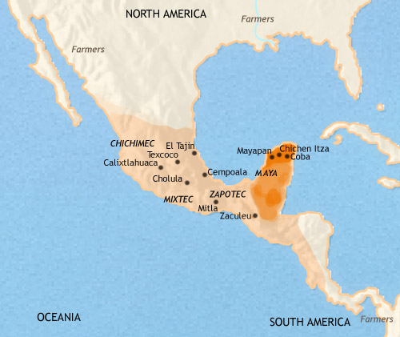
Meso-America 979-1215 CE
After ruling the most extensive empire in Mesoamerica's Pre-Columbian history, the Toltec empire has ceased, their capital, Tula, sacked (1156) by a people from the north, the Mexica. According to their foundation-legends, the Mexica, the forebears of the Aztec, were one of a number of peoples who came into Mesoamerica from the north in the 12th and 13th centuries. They have established themselves on a swampy island in Lake Texcoco, and serve as mercenary soldiers for the competing city-states of the area.
The period is a fruitful one for a band of mercenaries. Central Mexico is now the setting for internecine warfare between numerous city-states. Incoming barbarian peoples such as the Mexica complicate the situation, allying themselves now with one, now with another of the older states, and disrupting the more established urban societies of the region.
In the old Mayan homeland of the Yucatan Peninsula, Uxmal fell into decline after c. 1000, leaving Chichen Itza as the undisputed leader in the north. This was also a trading centre, with strong commercial links to the Gulf coast and central Mexico. Through Chichen Itze Mexican cultural influences spread through northern Yucatan.

Slide 14
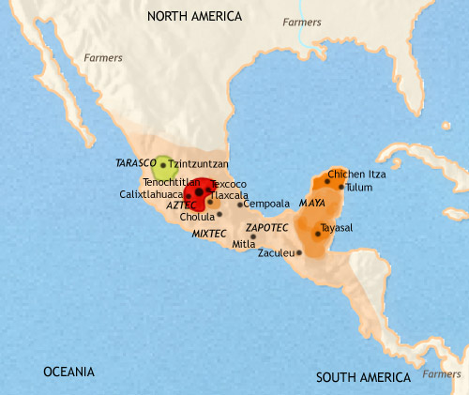
Meso-America 1215-1453 CE
Mesoamerica continued to be fragmented amongst numerous tribes and city-states during the 13th and 14th centuries. Then, in the 15th century the Mexica people became the leading element in a new alliance of peoples, the Aztecs. Since then this group has been busy extending its power over its neighbours. The Aztecs now dominate the Valley of Mexico. Their capital, Tenochtitlan, is already a huge city, perhaps 150,000 strong – very much larger than most Old World cites of the time.

Slide 15
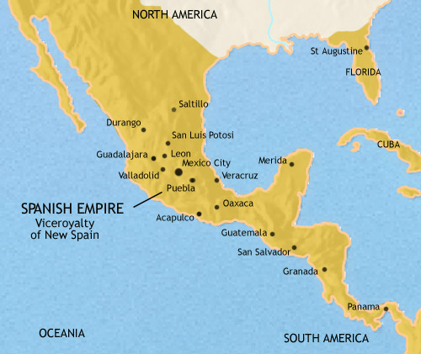
Meso-America 1453-1648 CE
The Aztecs conquered a large empire covering much of Mexico and Central America, before they themselves were suddenly conquered by a small band of Spanish soldiers, under the command of the conquistadore, Hernando Cortez. Arriving in Mexico in 1519 with 200 men, Cortez had completed the conquest of the country by 1522 -an achievment only made possible with the aid of the Aztec’s many native enemies.
With Mexico and the other countries of Central America under their control, the Spanish seized the land and distributed it amongst themselves. As for the native population, millions died from the diseases that the Europeans brought with them, to which they had no immunity. Most of the rest find themselves reduced to serfdom on huge estates owned by the conquistadores, called encomiendas, The great cities of the past are deserted and left to crumble away, to be rediscovered centuries later.
The Catholic church has taken control of the spiritual life of the inhabitants, and the old religions remain only as part of the strong folk tradition of the native Americans.

Slide 16
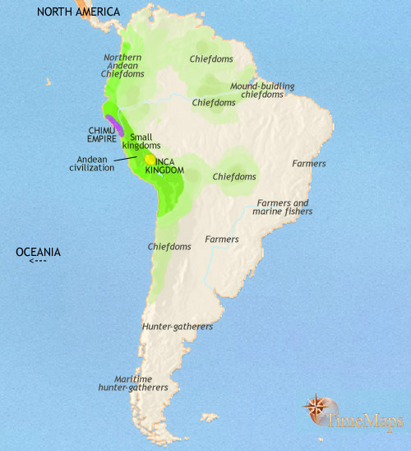
South America 1215 CE
Over the past two centuries, the Huari and Tiwanaku kingdoms have vanished. The Chimu empire has become the leading state in the Andean region. It is a highly centralized empire, with a well-developed road network spreading out from its imposing capital, Chan-Chan, and extensive irrigation and drainage systems. It is, in fact, developing many of the imperial policies which the Incas, who at this time form a small kingdom in the High Andes, will later take over and extend throughout a much vaster area. In the arts, the Chimu use highly developed techniques in metal working, textiles and the mass-production of pottery. In Amazonia, several large towns and cities are now flourishing, the centres of powerful kingdoms and extensive trading networks. Their fine ceramics, figurines and jewellery indicate the existence of a class of professional craftsmen serving a cultured urban elite.

Slide 17
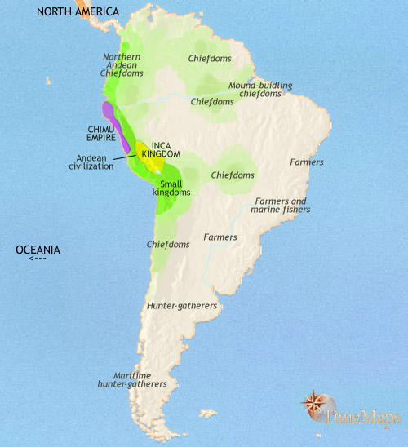
South America 1215-1453 CE
The past centuries have seen the Chimu empire continue to dominate the northern areas of the Andes civilization. However, a new power is on the rise, that of the Incas. The Inca tribe settled a valley in the High Andes of Peru in around 1200, where they founded their capital, Cuzco. It was not until 1438 that they became a strongly centralized state, but they have now begun their great series of conquests. Meanwhile, the towns and states of central Amazonia continued to be home to complex, hierarchical societies. Well-organized chiefdoms are also to be found on the fringes of the Amazon region, both to north and south. Elsewhere in South America, on the eve of European contact, people live in small farming villages or mobile hunter-gatherer groups, much as they have done for hundreds or thousands of years.

Slide 18
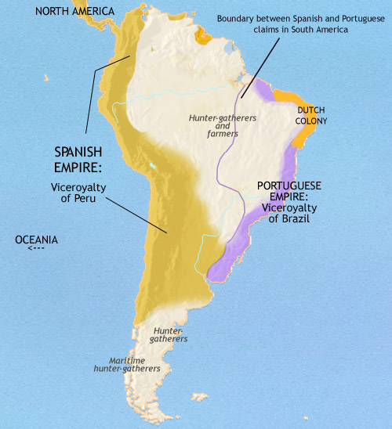
South America 1453-1648 CE
During the past two centuries, the peoples of South America have seen vast changes. The Inca conquered the Chimu empire in the 1470's; and more conquests followed, until they ruled an enormous empire, covering most of western South America. This great state suddenly disintegrated on the arrival of the Spaniard Francisco Pizzaro in 1532, with his horse-riding, firearms-toting soldiers. This launched a new phase in South American history, with much of the continent rapidly coming under European - mainly Spanish and Portuguese - control. In the decades following European contact, disease, enslavement and land seizure destroyed the advanced civilizations of the continent, both in the Andes and the Amazonregions, sending the surviving inhabitants back to a far simpler social organization. The Spanish empire in South America runs from Venezuela in the north to Argentina and Chile in the south. Spanish rule is bolstered by the Catholic Church. Colonial society in the Spanish empire is dominated by the great landowners, descendants of the Conquistadores. The silver mines of Peru, Colombia and Bolivia are the empire's chief economic asset. On the west coast, neglect by the Portuguese of their Brazilian possessions has led other Europeans, notably the Dutch, to establish their own colonies in the region.

