Slide 1
China Maps

Slide 2
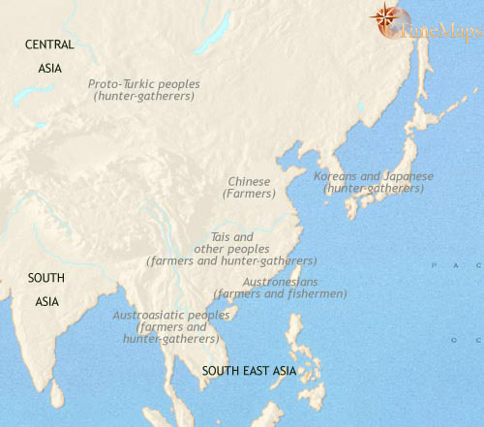
China 3500BCE
Stone-Age farming cultures had emerged in the two great river valleys of China by around 6000 BC. On the Yellow River plains of northern China millet was the main crop, whilst in the Yangze Valley to the south wet-rice cultivation predominated. By 3500 BC, both regions were home to well-established farming communities, and agriculture was beginning to spread to neighboring regions. Millet farming had recently arrived in the Korean peninsula from northern China, while wet-rice cultivation was beginning to spread into southern and eastern China. Japan, meanwhile, remained home to the oldest and most advanced hunter-gatherer culture in the world, the Jomon.

Slide 3
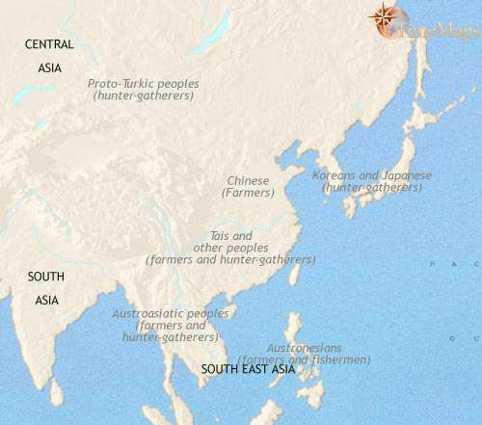
China 3500-2500 BCE
The past thousand years have seen the two farming traditions, the one based on millet, the other based on rice, continue to expand in East Asia. In particular wet-rice agriculture is spreading outwards from its core area in the Yangze Valley in all directions. From the southern China region will spring two major migrations down into South East Asia, one moving down from South West China, the other from the south China coast. The end point of these migrations will occur thousands of years hence, as far afield as Africa and Hawaii.
In both northern and southern China, material culture is advancing, and both have seen the rise of powerful chiefdoms who can support the services of skilled craftsmen. Trade routes cover the entire East Asia region (except Japan), leading to cultural and technological exchanges between the widely dispersed areas; and East Asia has also received influences from further west: horse-riding nomads from the steppes of Central Asia arrive bringing with them skills in metallurgy.
To the north east, millet cultivation has spread across the Korean peninsula, whilst in Japan, the Jomon hunter-gatherer culture continues to thrive.

Slide 4
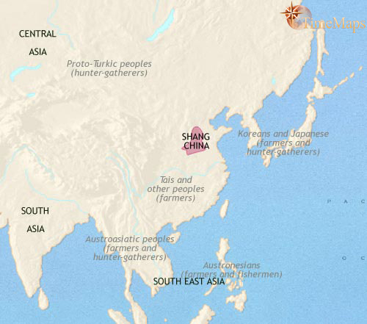
China 2500-1500 BCE
Over the past thousand years trade networks have grown to cover the area of present-day China, which results, amongst other developments, in the spread of metallurgy into the Yellow River and then the Yangze Valleys. This coincides with the emergence of urban civilization in these two regions. In particular, the rise of the Shang dynasty in northern China marks the beginnings of written history in China.
Meanwhile, rice farming is spreading into South East Asia from the present-day south China. Rice cultivation also appears in Korea. Japan, on the other hand, remains beyond the reach of agriculture, and the elaborate Jomon hunter-gatherer culture continues to thrive there.

Slide 5
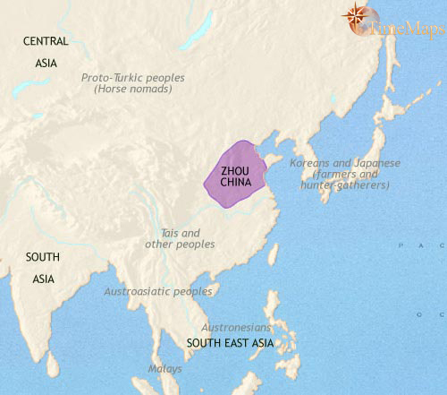
China 1500-1000 BCE
In the centuries since 1500 BC, the first dynasty in the history ofancient China, the Shang, has now given way to the Zhou. Under the Zhou, who have come from the fringes of the old Shang world, the various characteristics of Chinese civilization which developed under the Shang remain in place, though material and artistic culture may have declined somewhat for a time.
In southern Korea, wet-rice cultivation has established itself as the staple crop, though in the north millet and soybeans retained their dominance. Bronze technology reaches the Korean peninsula about now, from northern China. In Japan, the late Jomon people appear to be taking up farming as a minor part of their food culture, cultivating some local wild plants, such as yams and taro, as well as rice. Hunting and gathering remain the major preoccupations, however.

Slide 6
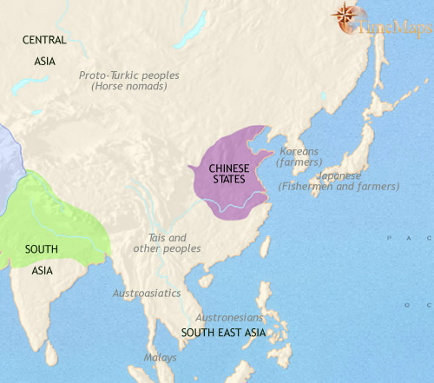
China 1000-500 BCE
The past centuries have seen the Zhou kingdom of northernChina fragment into a number of large, highly organized states. These are continually at war with one another. Despite this, civilization has made huge strides in all spheres. Iron farming tools have come into widespread use, greatly increasing food production; commerce and industry have expanded greatly. This is leading to widespread social change, and into this fluctuating environment comes one of the most important philosophers in world history, Confucius. His teachings will be hugely influential on the life and thought of the peoples of East Asia from ancient times right up to the present day.
Bronze age Korea is divided into numerous small but warlike chiefdoms, whose aristocracies have developed a fashion for large stone-built graves (dolmens), often furnished with bronze weapons, fine ceramics and jade objects as burial goods. Contacts between Korea and Japan are growing. At this time groups of Koreans are migrating to Japan, introducing their culture, based on rice cultivation, and their knowledge of bronze working, to the southern Japanese island of Kyushu.

Slide 7
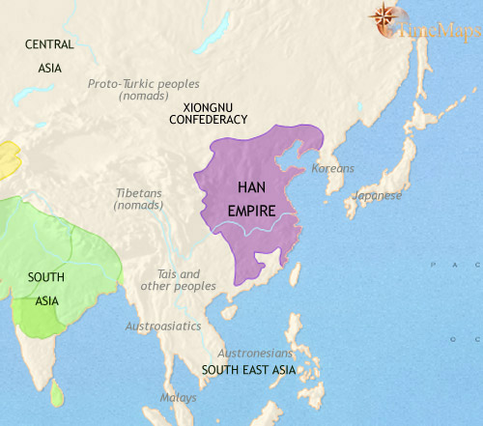
China 200-500 BCE
Civilization has continued to make remarkable advances within the Chinese world in recent centuries. A centuries-long phase of continuous warfare between large, well-organized states has led to the emergence of one super-state covering the whole of ancient China. This is ruled by the Han dynasty. These developments within China have been matched by the union of nomadic tribes on the eastern steppes of central Asia under Hun leadership. This is the first of a series of warlike nomadic confederacies that will have a profound impact on east Asian history.
The use of iron has spread to both Korea and Japan by this date. In Korea, powerful chiefdoms centred on small walled towns have appeared, while in Japan, the rice-growing culture brought from Korea in about 500 BC - which in Japan is called the Yayoi culture - is gradually spreading north and east.

Slide 8
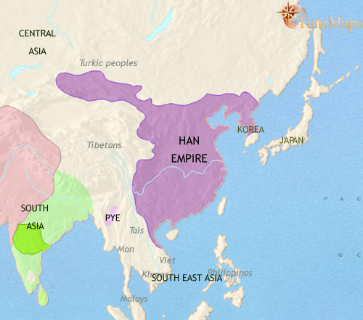
China 200-30 BCE
The Han dynasty has now ruled a united China for 200 years. Externally, the Han emperors have presided over a huge expansion of the Chinese empire, and the internal peace they have maintained has led to an upsurge in prosperity and in material civilization. The Han government has adopted Confucianism as its official ideology, and in this as in many other ways it lays the foundation for much future history, of China as well as other East Asian nations.
With China now unified and able to exert great power beyond its borders, central Asia in the west, Korea in the north and Vietnam in the south have been drawn deeply into its orbit, with a large portion of each becoming integral parts of the Chinese empire.Japan, also, has come to some extent under China's influence. This country has seen the rise of powerful and warlike chiefdoms, some of whom pay tribute to the imperial Chinese court.

